Slide 1
Bai 27 De Cuong Trang 31 – 2 cap tiep tuyen cat nhau
Bai 49 De Cuong = De Thay Sang
Bai 28 De Cuong - Hay

Slide 2
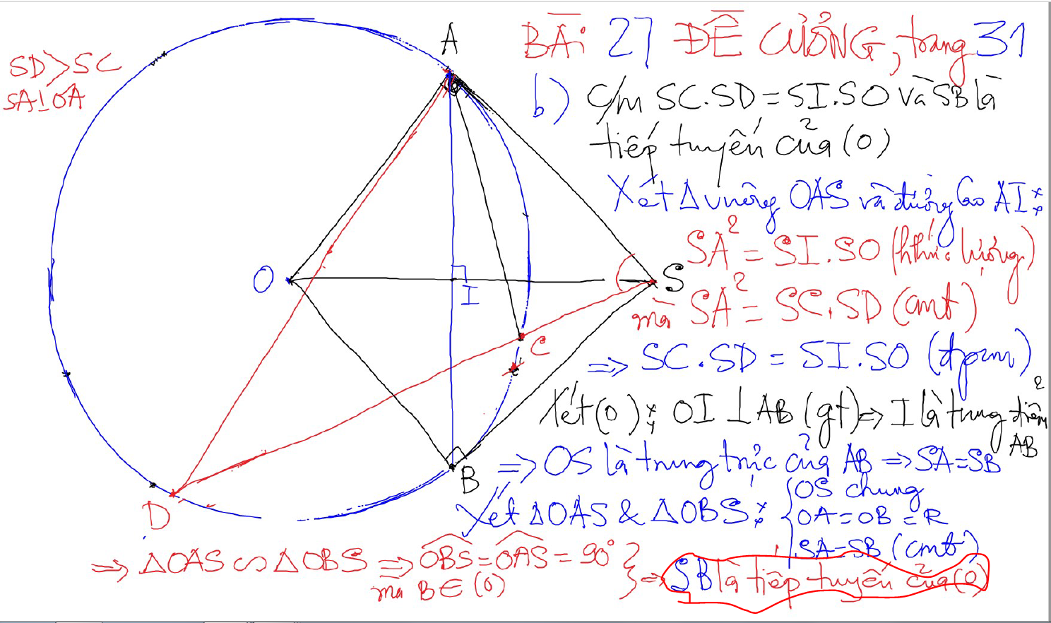
Bai 27 De Cuong Trang 31 – 2 cap tiep tuyen cat nhau

Slide 3
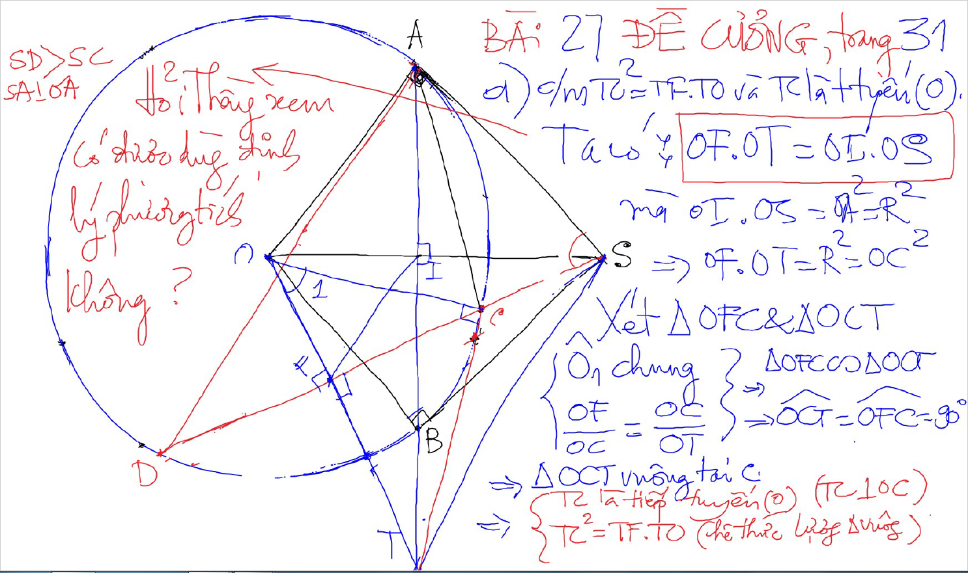
Bai 27 De Cuong Trang 31 – 2 cap tiep tuyen cat nhau

Slide 4
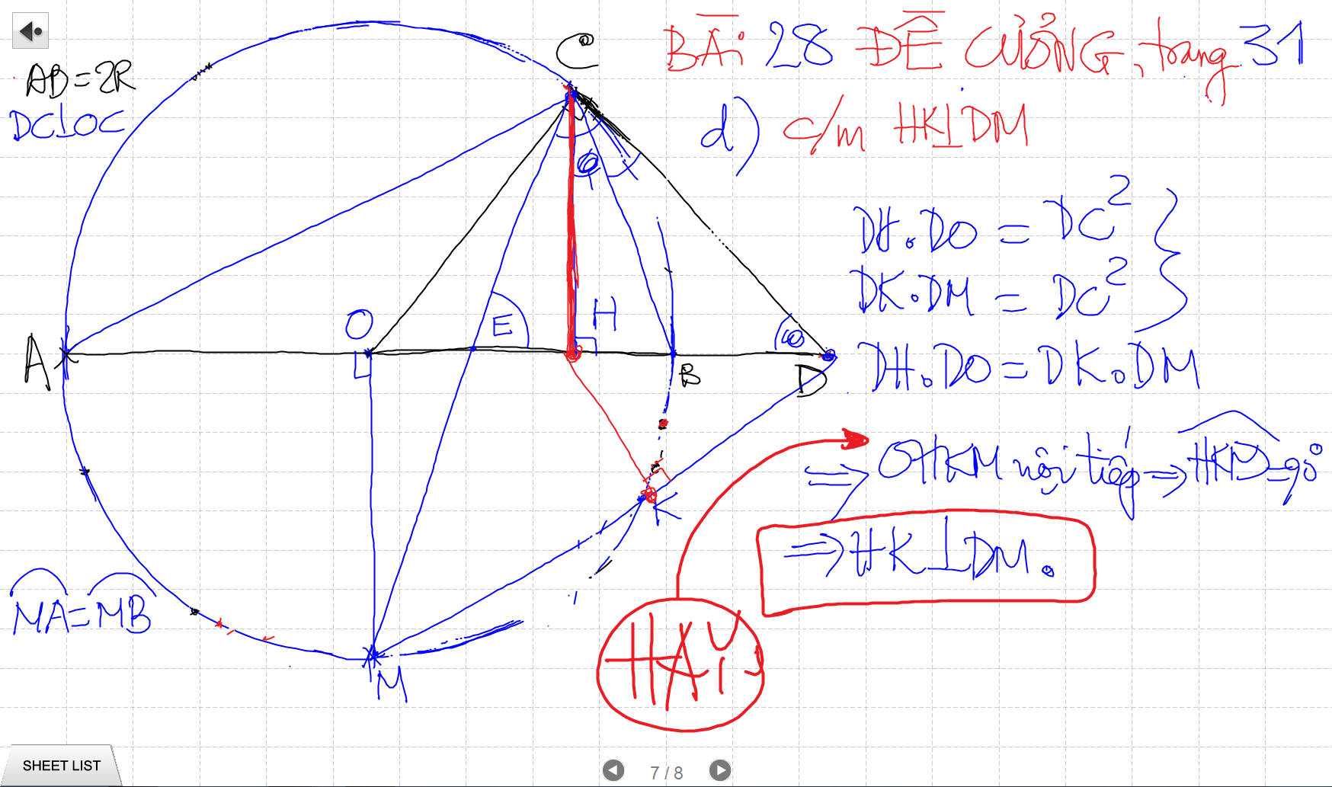
Bai 27 De Cuong Trang 31 – 2 cap tiep tuyen cat nhau

Slide 5
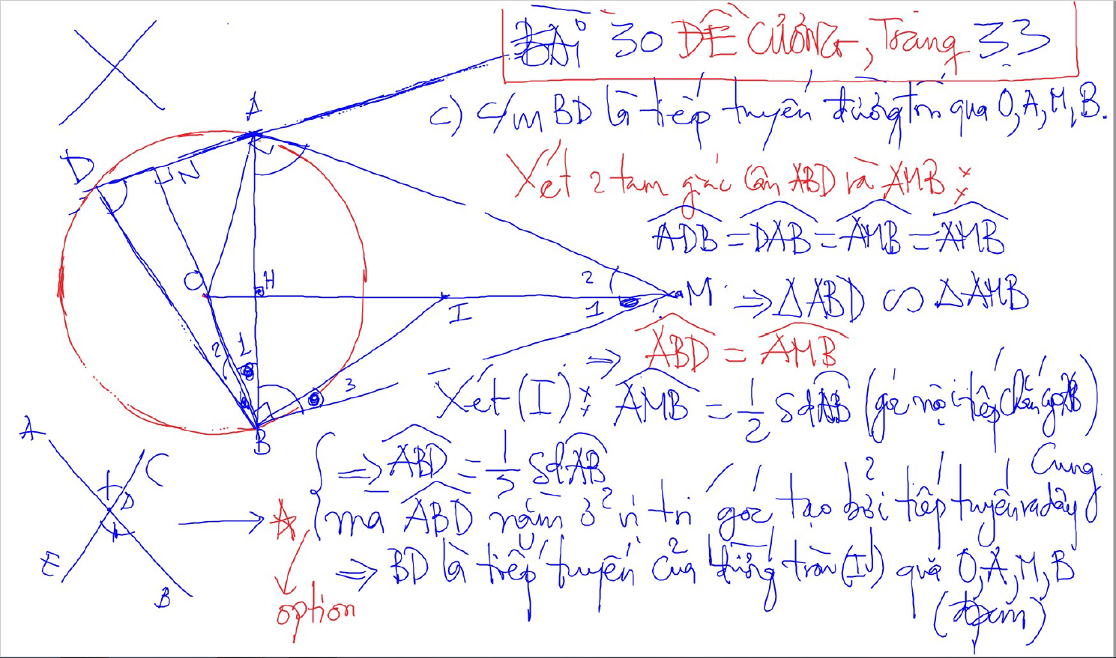

Slide 6
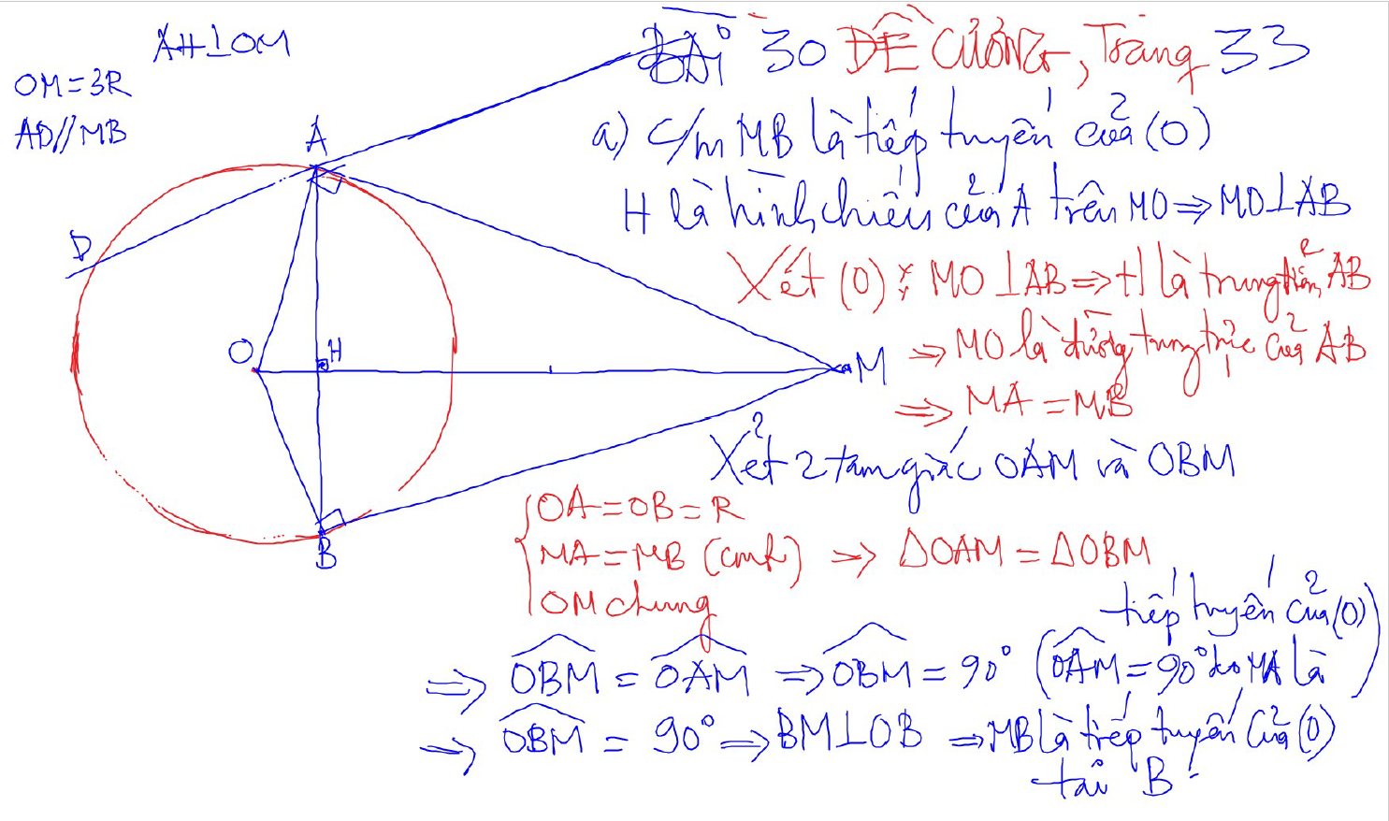

Slide 7
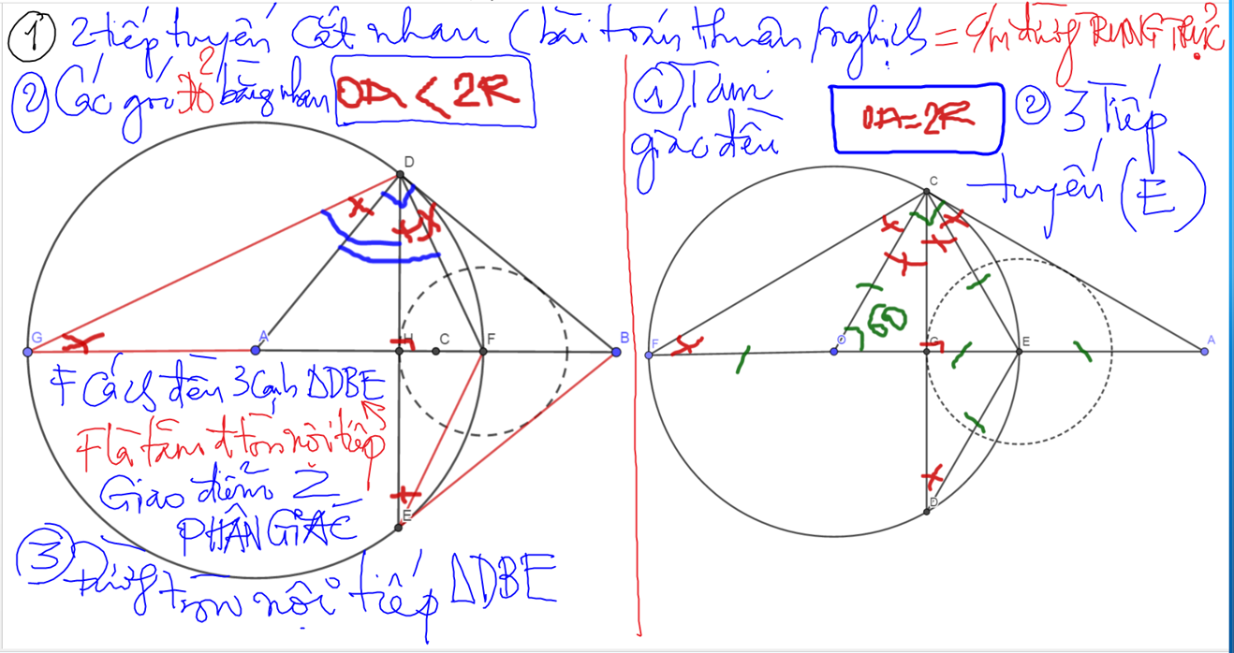

Slide 8
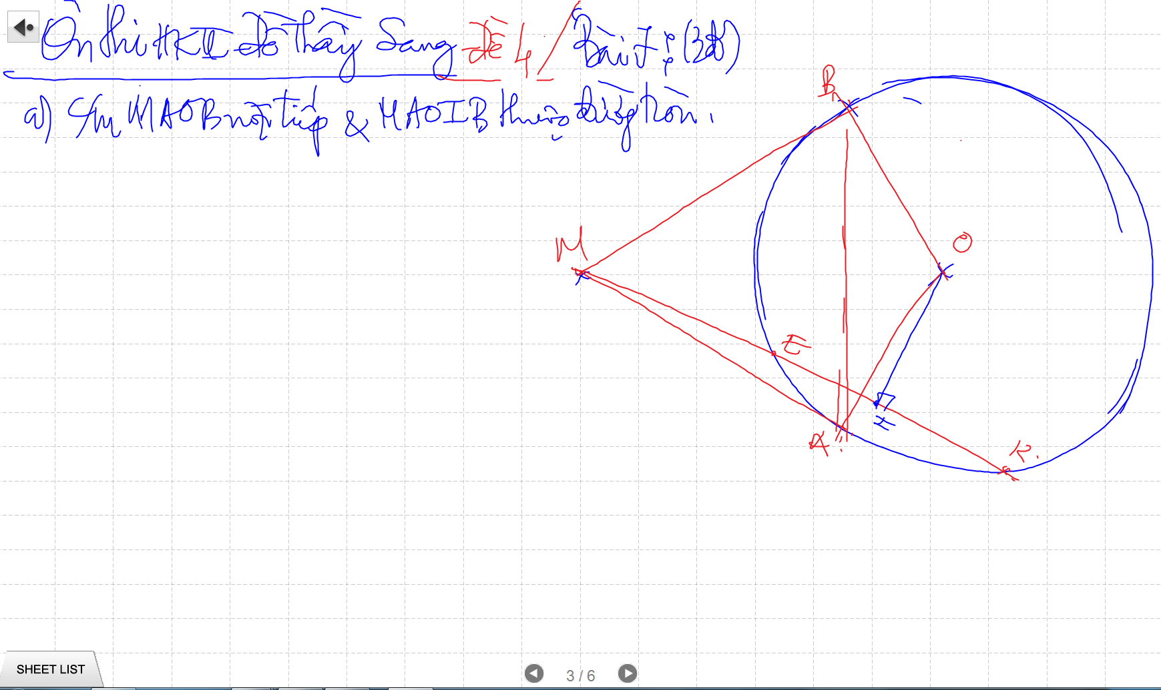

Slide 9
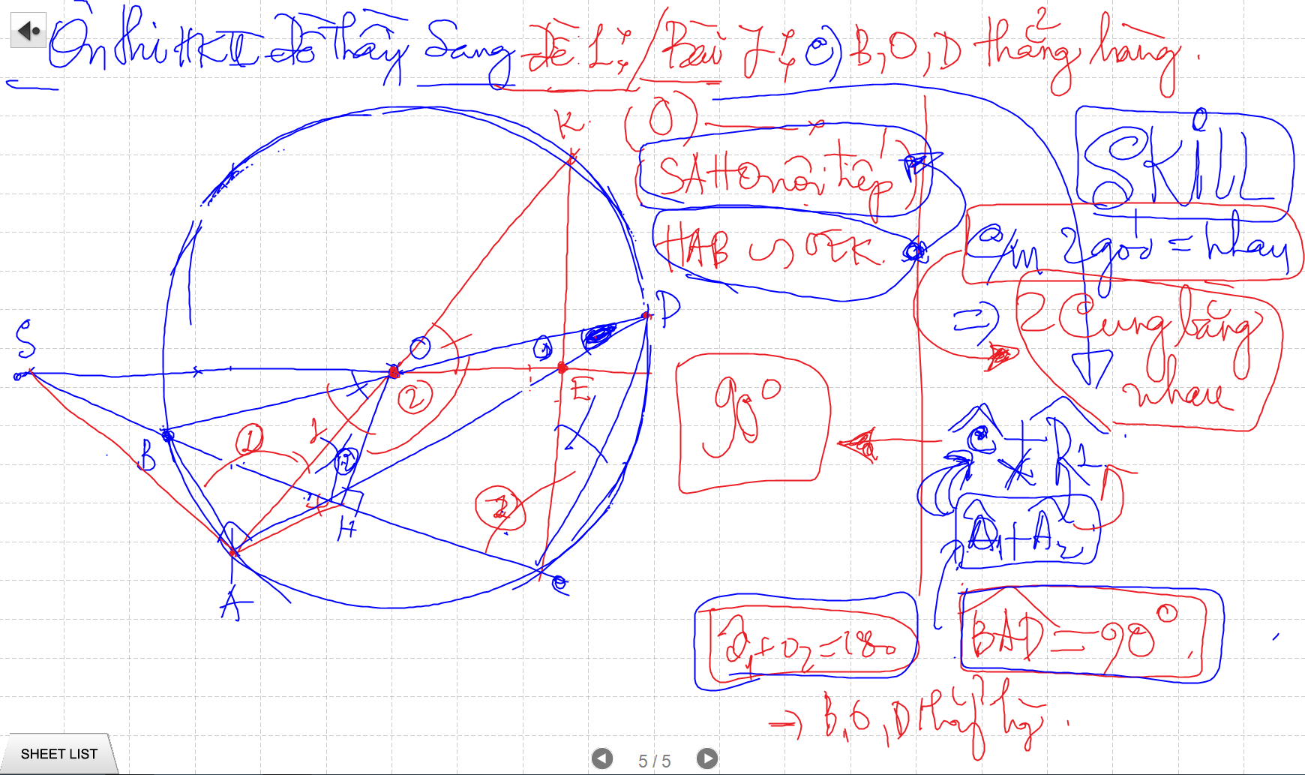

Slide 10
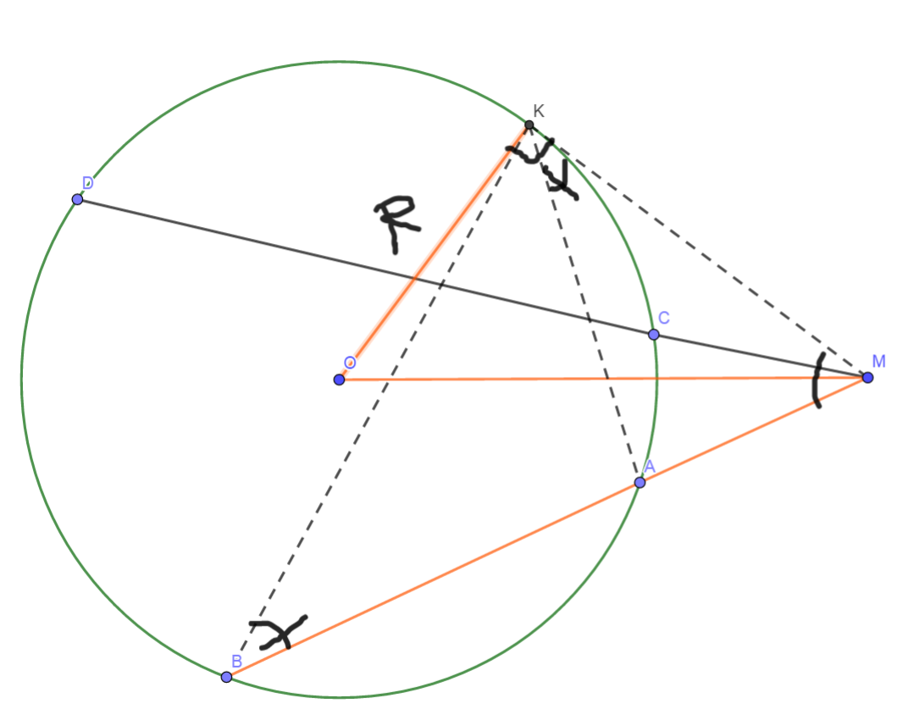
Phuong Tich cua mot diem nam ben ngoai duong tron
MA.MB=OM²-R²
He qua:
MA.MB=MC.MD=OM²-R²

Slide 11
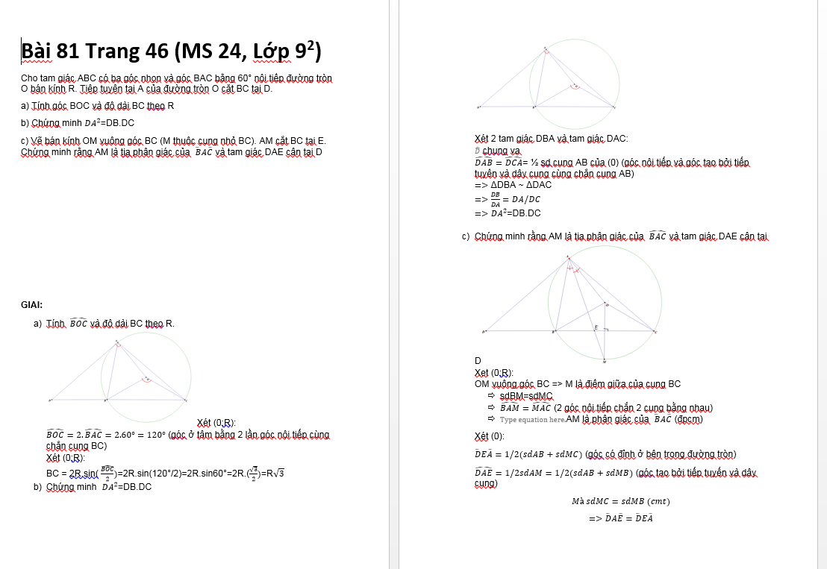

Slide 12
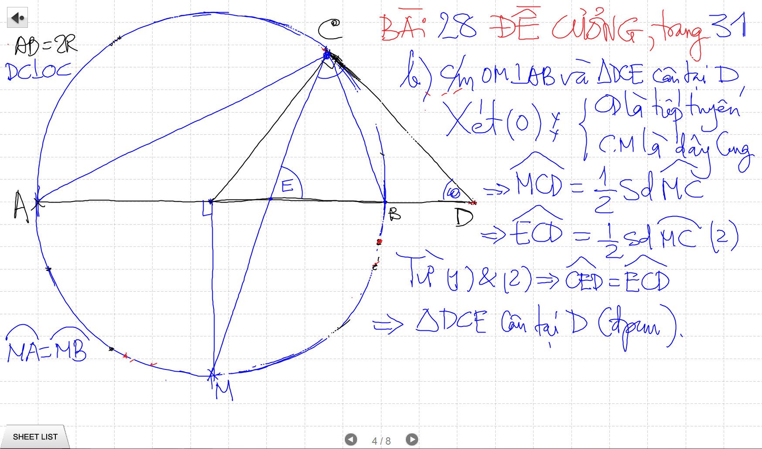
Cac De nay kho vi no TRUU TUONG. Phai co kinh Nghiem biet doi nhanh cac bieu thuc SO HOC

Slide 13
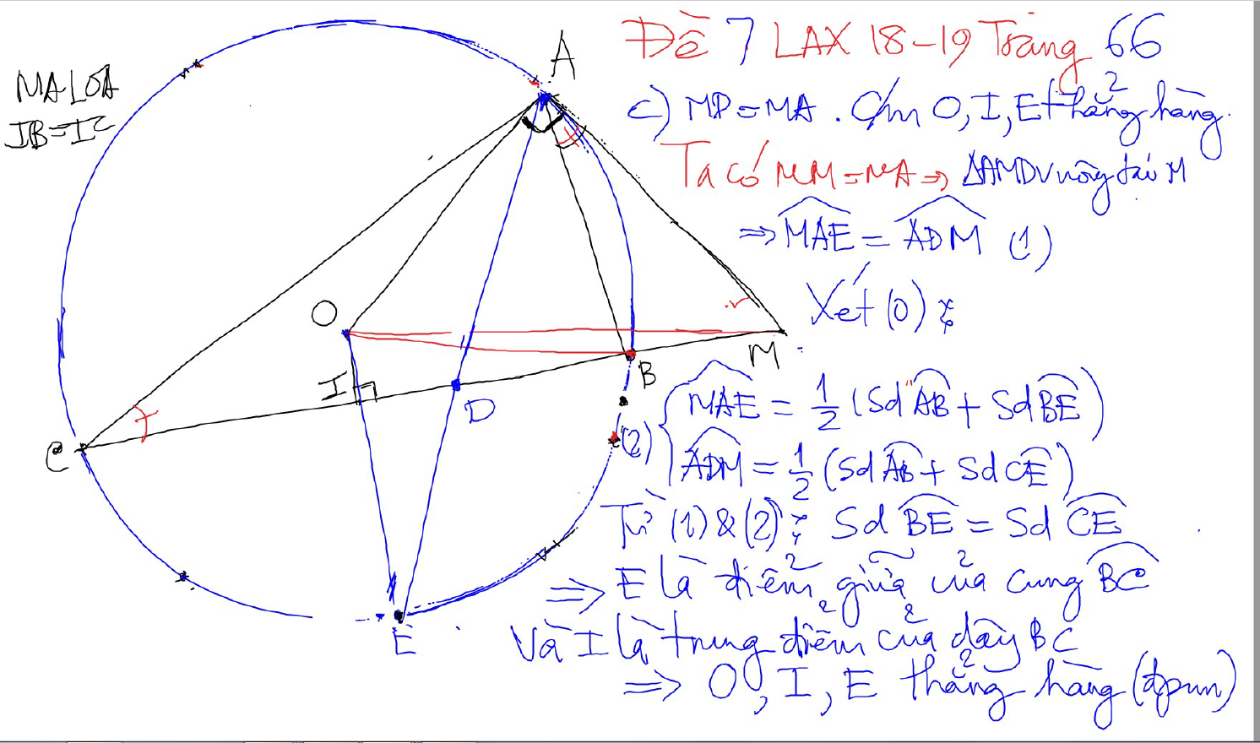
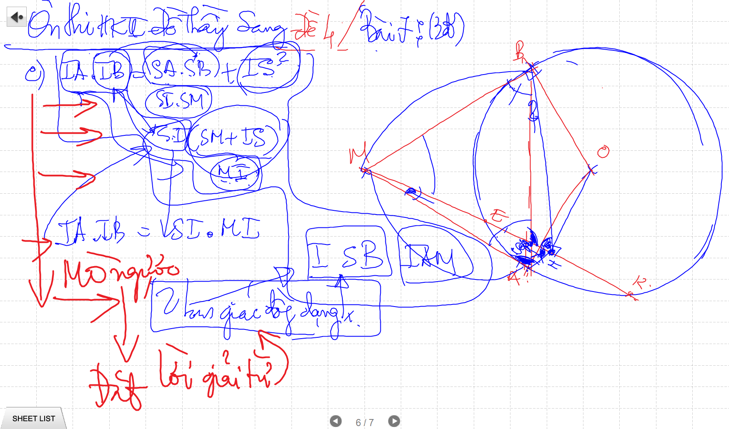
Cac De nay kho vi no TRUU TUONG. Phai co kinh Nghiem biet doi nhanh cac bieu thuc SO HOC

Slide 14
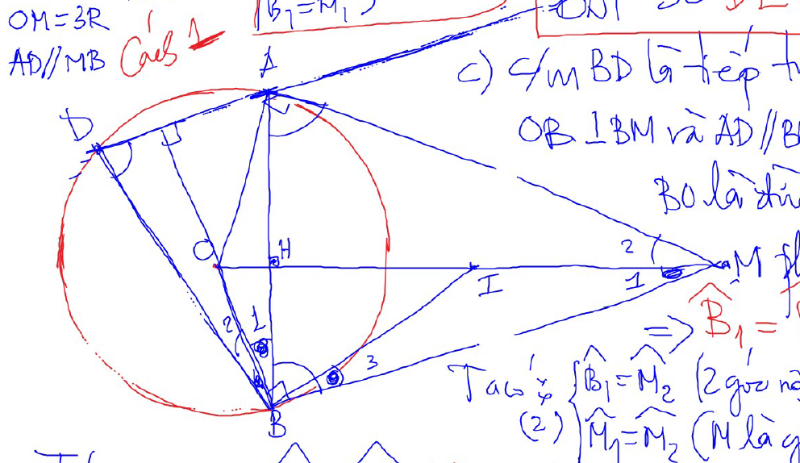
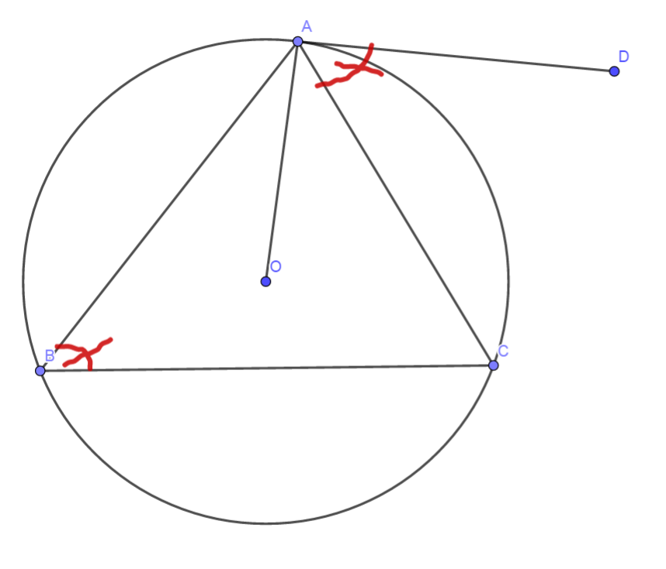
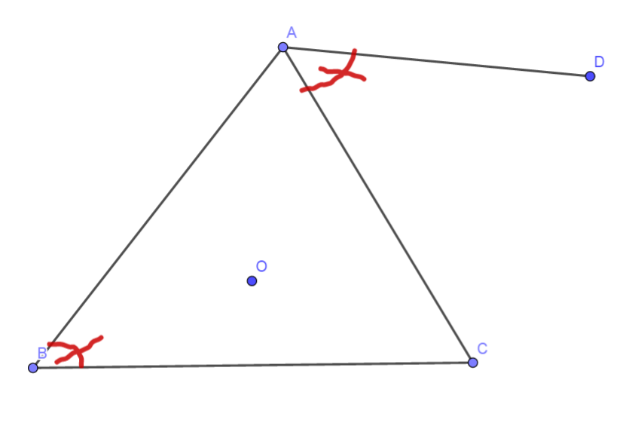
Chung minh tiep tuyen bang dinh ly dao cua goc tao boi tiep tuyen va day cung va goc noi tiep cung chan 1 cung:
GT: Goc ABC = Goc DAC
KL: DA la tiep tuyen

Slide 15
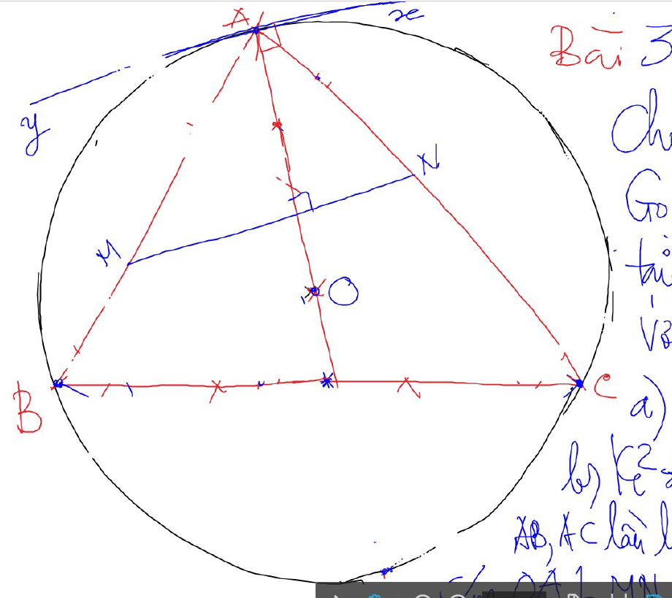
Ve them tiep tuyen de chung minh mot duong thang vuong goc voi ban kinh

Slide 16
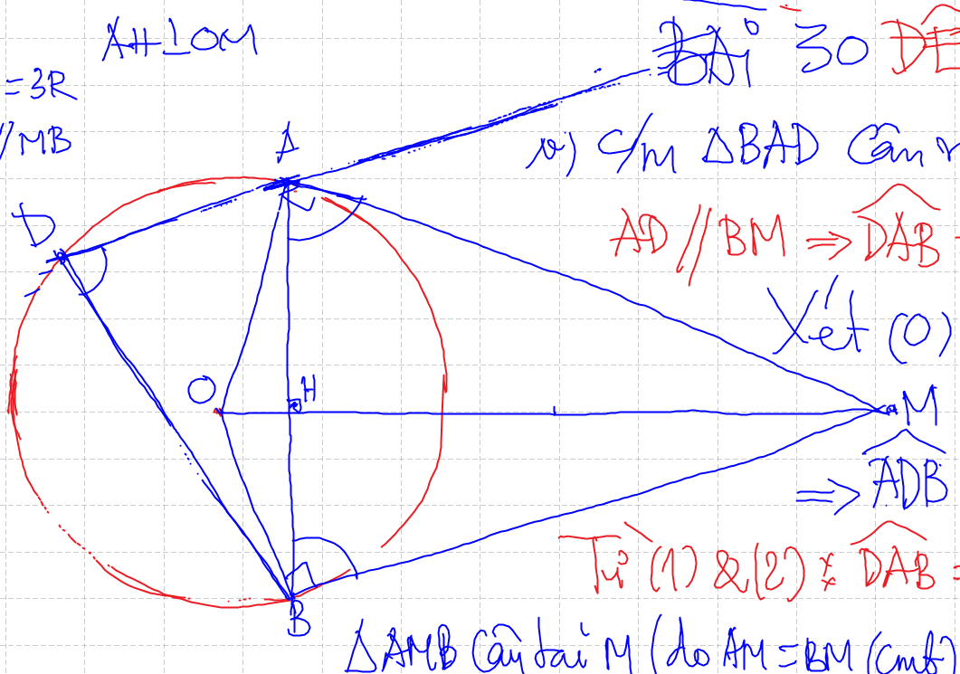
Cach ve 2 duong thang song song
Các góc so le trong (đồng vị, trong cùng phía)
Đường thẳng vuông góc với 2 đường song song
Goc tao boi tiep tuyen va day cung luon co 2 goc bu nhau, tuong ung chan cung lon va cung nho
Sin va cos thuc chat la ty so. Nhung khong phai ty so dong dang cua 2 tam giac. Ma la ty so luong giac (ty so giua 2 canh cua cung 1 tam giac).
Muon dung sin/ cos de tinh chieu dai, thi khong doi ra do (so do goc). Ma chi giu nguyen sin/cos (2 goc bang nhau thi sin/ cos bang nhau)

